Slide 1
Chapter 4: IO Management
I/O HARDWARE
Computers operate on many kinds of devices. General types include storage devices (disks, tapes), transmission devices (network cards, modems), and human-interface devices (screen, keyboard, mouse).
A device communicates with a computer system by sending signals over a cable or even through the air.
The device communicates with the machine via a connection point termed a port (for example, a serial port).
If one or more devices use a common set of wires, the connection is called a bus.

Slide 2
Device Controllers (adapter)
A device controller is a hardware unit which is attached with the input/output bus of the computer and provides a hardware interface between the computer and the input/output devices.
On one side it knows how to communicate with input/output devices and on the other side it knows how to communicate with the computer system though input/output bus.
Typically the controller is on a card (e.g. LAN card, USB card etc).
Device Controller play an important role in order to operate that device. It's just like a bridge between device and operating system.

Slide 3
Cont…
Most controllers have DMA(Direct Memory Access) capability, that means they can directly read/write memory in the system.
A controller without DMA capability provide or accept the data, one byte or word at a time; and the processor takes care of storing it, in memory or reading it from the memory.

Slide 4
Cont…
Memory is not the only resource that the operating system must manage. I/O devices also interact heavily with the operating system.
The controller is a chip or a set of chips on a plug-in board that physically controls the device.
It accepts commands from the operating system, for example, to read data from the device, and carries them out.
In many cases, the actual control of the device is very complicated and detailed, so it is the job of the controller to present a simpler interface to the operating system.

Slide 5
Device driver
device driver is a computer program that operates or controls a particular type of device that is attached to a computer.
A driver provides a software interface to hardware devices, enabling operating systems and other computer programs to access hardware functions without needing to know precise details about the hardware being used.
When a calling program invokes a routine in the driver, the driver issues commands to the device. Once the device sends data back to the driver, the driver may invoke routines in the original calling program. Drivers are hardware dependent and operating-system-specific.

Slide 6
Cont…
The device driver is a communication program between the I/O process and the device controller.
The kernel of the OS interacts with the I/O device through the device driver.
Actually, the device driver is the only interface which connects the I/O device and the kernel.
Only the device driver knows the details of the I/O devices

Slide 7
Interrupts
Interrupts are very important in operating systems and controller, so let us examine the idea more closely.
In Fig bellow. we see a three-step process for I/O. In step 1, the driver tells the controller what to do by writing into its device registers. The controller then starts the device.
When the controller has finished reading or writing the number of bytes it has been told to transfer, it signals the interrupt controller chip using certain bus lines in step 2.
If the interrupt controller is prepared to accept the interrupt (which it may not be if it is busy with a higher priority one), it asserts a pin on the CPU chip informing it, in step 3.
In step 4, the interrupt controller puts the number of the device on the bus so the CPU can read it and know which device has just finished (many devices may be running at the same time).

Slide 8
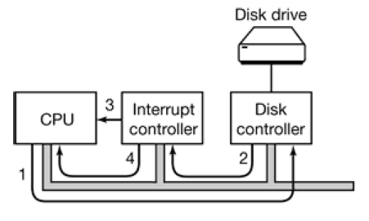
The steps in starting an I/O device and getting an interrupt

Slide 9
CONT…
Once the CPU has decided to take the interrupt, the program counter is typically then pushed onto the current stack and the CPU switched or jumps into kernel mode to find the interrupt-handler routine at a fixed address in memory.
The device number may be used as an index into part of memory to find the address of the interrupt handler for this device. This part of memory is called the interrupt vector.
The interrupt handler determines the cause of the interrupt, performs the necessary processing, then handler clears the interrupt by servicing the device.
Then interrupt handler executes a return from interrupt instruction to return the CPU to the execution state prior to the interrupt.

Slide 10
Cont…
An interrupt huddler, also known as an interrupt service routine(ISR) is a piece of software or more specially a callback function in an operating system or more specifically in device driver.
The operating system can distinguish between high- and low-priority interrupts, and can respond with the appropriate degree of urgency.

Slide 11
Types of interrupts
The CPU hardware has a wire called the interrupt request line that the CPU senses after executing every instruction.
The device controller raises an interrupt by asserting a signal on the interrupt request line. These interrupt is either:-
1,Non-maskable interrupt, which is reserved for events such as unrecoverable memory errors.
2. Maskable interrupt. It can be turned off by the CPU before the execution of critical instruction sequences that must not be interrupted.

Slide 12
Registers Controller
Every controller has a small number of registers that are used to communicate with it.
For example, disk controller might have registers for specifying the disk address, memory address, sector count, and direction (read or write).
To activate the controller, the driver gets a command from the operating system, then translates it into the appropriate values to write into the device registers.
The device registers are put in a special I/O port space, with each register having a port address.
On these machines, special IN and OUT instructions are available in kernel mode to allow drivers to read and write the registers.

Slide 13
I/O port typically consists of four registers.
1.Status register:-contains bits that can be read by the host. This bit indicate states such as whether the current command has completed, whether bytes available to be read from the data in register and whether there is a device error.
2. Control register:- it can be written by the host to start a command or to change a mode of a device.
3.Data in register:- it is read by the host to get input.
4.Data out register:- it is written by the host to send output.

Slide 14
Application I/O Interface
Application I/O Interface represents the structuring techniques and interfaces for the operating system to enable I/O devices to be treated in a standard, uniform way.
Following are the characteristics of I/O interfaces with respected to devices.
Character-stream / block - A character-stream device transfers bytes in one by one fashion, whereas a block device transfers a complete unit of bytes.
Sequential / random-access - A sequential device transfers data in a fixed order determined by the device, random-access device can be instructed to seek position to any of the available data storage locations.
Synchronous / asynchronous - A synchronous device performs data transfers with known response time where as an asynchronous device shows irregular or unpredictable response time.
Sharable / dedicated - A sharable device can be used concurrently by several processes or threads but a dedicated device cannot be used.
Speed of operation - Device speeds may range from a few bytes per second to a few gigabytes p/s.
Read-write, read only, or write only - Some devices perform both input and output, but others support only one data direction that is read only.

Slide 15
Method for make i/o functional.
Input and output can be done in three different ways. In the simplest method, a user program issues a system call, which the kernel then translates into a procedure call to the appropriate driver.
The driver then starts the I/O and sits in a tight loop continuously polling the device to see if it is done (usually there is some bit that indicates that the device is still busy).
When the I/O has completed, the driver puts the data where they are needed (if any), and returns.

Slide 16
CONT…
The operating system then returns control to the caller. This method is called busy waiting and has the disadvantage of tying up the CPU polling the device until it is finished.
The second method is for the driver to start the device and ask it to give an interrupt when it is finished. At that point the driver returns.
The operating system then blocks the caller if need be and looks for other work to do.
When the controller detects the end of the transfer, it generates an interrupt to signal completion.

Slide 17
Cont…
The third method for doing I/O makes use of a special DMA (Direct Memory Access) chip that can control the flow of bits between memory and some controller without constant CPU intervention.
DMA is a memory-to-device communication method that by passes the CPU.
That means many computers avoid burdening the main CPU with programmed I/O by offloading some of this work to a special purpose processor.
This type of processor is called, a Direct Memory Access (DMA) controller. used to transfer block of data directly between an external device and the main memory, without intervention by the processor.
DMA controllers can transfer data much faster than non-DMA controllers.

Slide 18
SECONDARY STORAGE MANAGEMENT
Disk provide bulk of secondary storage of computer system. The disk can be considered the one I/O device that is common to each and every computer.
Disks come in many size and speeds, and information may be stored optically or magnetically.
By contrast, the hard drive is vastly larger in storage capacity and much faster.
It has to be because it holds the operating system, your application programs, and your data files.

Slide 19
Disk is divided into
A disk is divided into platters, tracks, cylinders, and sectors.
Platters and media:-A hard disk driver consists of on one or more flat circular discs called platters on witch data is stored. Here different platters are stacked one above the other.
A track:- is that portion of a disk which passes under a single stationary head during a disk rotation, a ring 1 bit wide.
A cylinder:- is comprised of the set of tracks described by all the heads (on separate platters) at a single seek position. Each cylinder is equidistant from the center of the disk. The cylinder value is the number of tracks on one side of each platter.
A track:- is divided into segments of sectors, which is the basic unit of storage.
Cluster:- A cluster consists of one or more sectors that the OS can allocate to a file. As sector is the basic unit of data storage on a hard disk. A single track typically can have thousands of sectors and each sector can hold more than 512 bytes of data.

Slide 20
Cont…
The number of sectors per track varies with the radius of the track on the platter.
The outermost tracks is larger and can hold more sectors than the inner ones.
These outer tracks also spin faster under the head than do the inner ones, because while the angular speed remains the same, the larger circumference results in more sectors spinning by in the same period for the outer tracks.

Slide 21
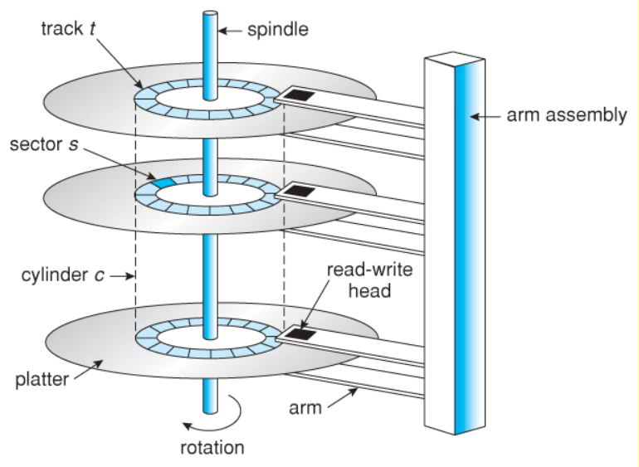
Cont..

Slide 22
Four key components of hard disk
The hard drive, which typically provides storage for data and applications within a computer, has four key components inside its casing.
The platter (for storing data), the spindle (for spinning the platters), the read/write arm (for reading and writing data) and the actuator (for controlling the actions of the read/write arm).
Only the most technically proficient IT professionals should attempt to work on the components inside a hard drive.

Slide 23
Disk Performance Parameters
Seek time: Seek time is the time required to move the disk arm to the required track. The seek time consists of two key components: the initial startup time and the time taken to traverse the tracks that have to be crossed once the access arm is up to speed.
Rotational delay: Time required to reach the desired sector by read or write head.
Transfer time: The transfer time to or from the disk depends on the rotation speed of the disk in the following fashion:
T= b/rN where T = transfer time, b = number of bytes to be transferred, N = number of bytes on a track r = rotation speed, in revolutions per second

Slide 24
Disk Management
What is disk formatting? Disk formatting is a process of configuring data storage device such as hard disk drive and other for initial use.
Operating system is responsible for disk management. Following are some activities discussed.
Disk Formatting is of two types.
Physical formatting or low level formatting.
Logical Formatting (high level formatting).

Slide 25
Physical Formatting (low-level formatting).
Low-level formatting is the process of marking out cylinders and tracks for a blank hard disk, and then dividing tracks into multiple sectors with sector markers. So, this process is actually a kind of physical formatting. And it is now often performed by hard disk manufacturers.
Disk must be formatted before storing data that means divided into tracks and sectors that the disk controllers can read/write which means dictates where data is stored on the disk.
Short for low-level format, a formatting method that creates the tracks and sectors on a hard disk.
Low level formatting is done at factory.

Slide 26
Logical Formatting (high-level formatting).
After disk is partitioned into low level formatting, logical formatting is used.
Logical formatting places a file system on the disk, allowing an operating system (such as DOS, OS/2, Windows, or Linux) to use the available disk space to store and retrieve files.
Operating system stores the initial file system data structures onto the disk.
Formatting hard disk usually done by user is the high-level formatting.

Slide 27
Disk Scheduling
If a device or controller is busy, any new requests for service will be placed on the queue of pending requests for that drive.
When one request is completed, the operating system chooses which pending request to service next. Different types of scheduling algorithms are as follows.
1.First Come, First Served scheduling algorithm (FCFS).
2.Shortest Seek Time First (SSTF) algorithm
3.SCAN algorithm
4.Circular SCAN (C-SCAN) algorithm
5.Look Scheduling Algorithm
6.C-LOOK

Slide 28
Disk Scheduling
What is disk scheduling?
Servicing the disk I/O requests
Why disk Scheduling?
Use hardware efficiently
Includes
Fast access time (seek time+ rotational latency)
Large disk bandwidth

Slide 29
Disk Scheduling
I/O request issues a system call to the OS and if desired disk drive or controller is available, request is served immediately.
If busy, new request for service will be placed in the queue of pending requests.
When one request is completed, the OS has to choose which pending request to service next.

Slide 30
FCFS Scheduling
All incoming requests are placed at the end of the queue. Whatever number that is next in the queue will be the next number served.
Simplest, perform operations by order of requested and no reordering of work queue.
no starvation: every request is serviced by order of arrival.
Doesn’t provide fastest service.
Ex: a disk queue with requests for I/O to blocks on cylinders 23, 89, 132, 42, 187 With disk head initially at 100

Slide 31
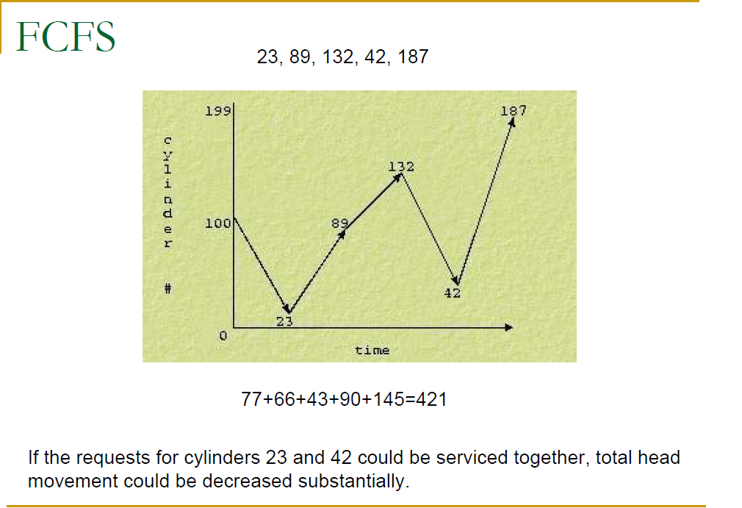
Cont…

Slide 32
SSTF Scheduling
In this case request is serviced according to next shortest distance.
Like SJF, select the disk I/O request that requires the least movement of the disk arm from its current position, regardless of direction reduces total seek time compared to FCFS.
Disadvantages
starvation is possible; stay in one area of the disk if very busy
switching directions slows things down
Not the most optimal

Slide 33
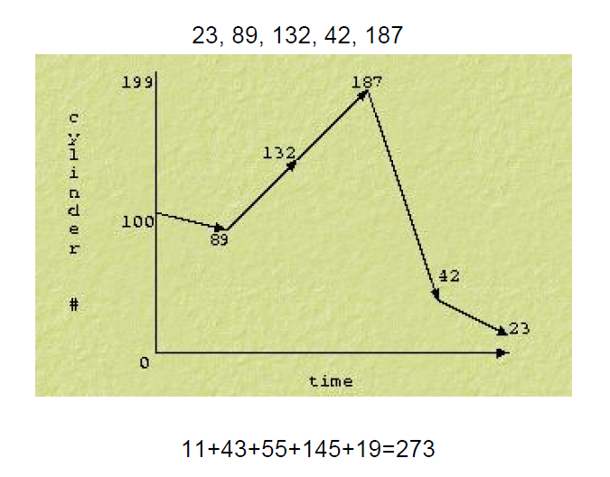
Cont…

Slide 34
SCAN
It scans down towards the nearest end and then when it hits the bottom it scans up servicing the requests that it didn't get going down.
If a request comes in after it has been scanned it will not be serviced until the process comes back down or moves back up.
Sometimes called the elevator algorithm.
Reduces variance compared to SSTF.

Slide 35
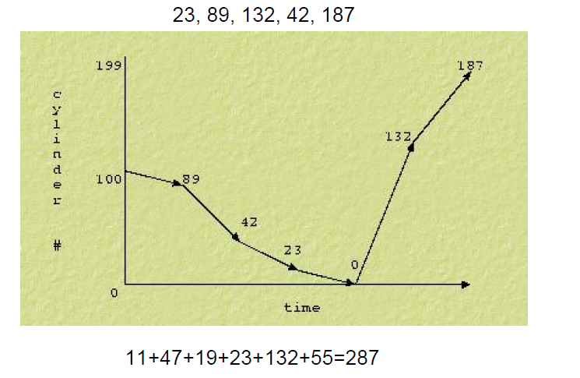
CONT…

Slide 36
C-SCAN
Circular scanning works just like the elevator to some extent. It begins its scan toward the nearest end and works it way all the way to the end of the system (end cylinder).
Once it hits the bottom or top of the system, then it jumps to the other end and moves in the same direction.
Keep in mind that the huge jump doesn't count as a head movement.

Slide 37
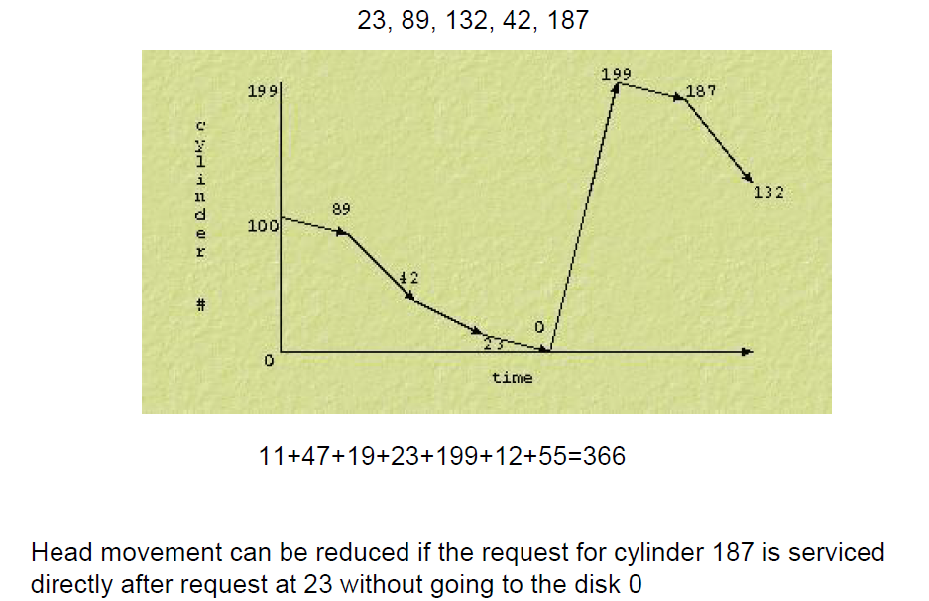
Cont…

Slide 38
LOOK
like SCAN but stops moving inwards (or outwards) when no more requests in that direction exist.

Slide 39
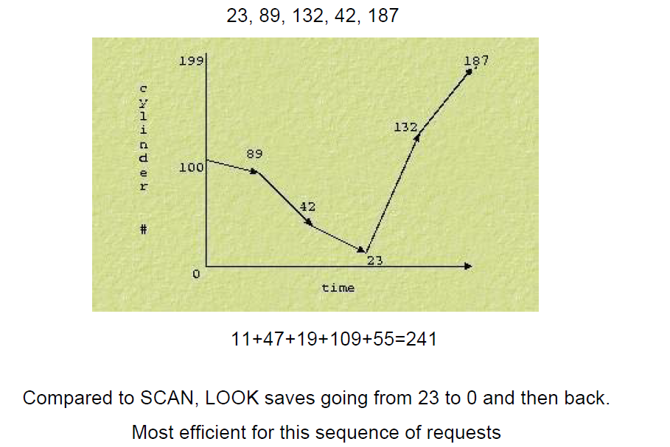
Cont…

Slide 40
C-LOOK
This is just an enhanced version of C-SCAN. In this the scanning doesn't go past the last request in the direction that it is moving.
It too jumps to the other end but not all the way to the end. Just to the furthest request.
Who sketch the symbolic diagram for this algorithm and calculate the total track moved by read write head?

Slide 41
The end
Thank you

